Slide 1
Inspire...Educate...Transform...
AI and Decision Sciences
Genetic Algorithms
Data Scientists
Notes:
1

Slide 2
Genetic Algorithm Logical flow
{
initialize population;
evaluate population;
while TerminationCriteriaNotSatisfied
{
select parents for reproduction;
perform recombination and mutation;
evaluate population;
}
}

Slide 3
Genetic Algorithms
Define Initial population size, elite percentage, mutation probability, crossover probability, fitness function and a fitness criteria if required.
Generate a random population of n possible solutions (Chromosomes)
Calculate the fitness for all the chromosomes.
Evaluate the new population based on the fitness criteria and repeat the process until fitness criteria is met.

Slide 4
Contd..
While stopping condition is not met, perform cross over or mutation based on the random number generated and generate new population.
For crossover : Select 2 parents from the elite and perform cross over the parents to form 2 new offspring.
We have used PMX crossover here.
For Mutation: Take 1 parent and mutate it to generate 1 child.
Note: Select top few based on the fitness criteria and add them to the next generation.

Slide 5
Contd..
If the stopping criterion is satisfied Stop and return the best solution.

Slide 6
Activity
Statement: You are planning to visit a few places in India, In the interest of time you have narrowed them down to 10 places, you start from Bangalore visit 10 places and come back to Bangalore.
We have generated a matrix with 10 places and the distances.
The goal is to cover all the places by travelling as little as possible, you decide to find the smallest distance possible using ‘Genetic Algorithm’.

Slide 7
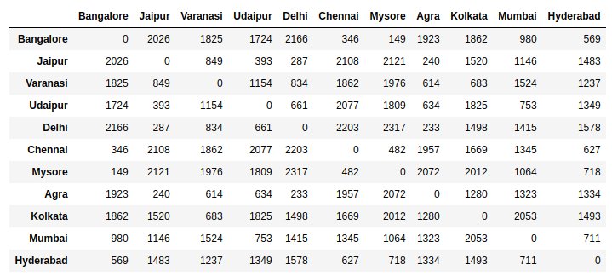
Data: (Distance matrix)

Slide 8
Terminology – Quick Recap
Gene: The reproducible building block of chromosome
Chromosome: A possible solution
Population: A set of chromosomes
Generation: A population derived from the fittest chromosomes of the previous population
Reproduction and Mutation: Create a new solution from the old fitter solutions

Slide 9
Functions Used
createRandomRoute – To generate random routes
fitnessFunction – To compute the route cost
mutateRoute – Generate Mutated Path
initialPopCost – To create initial population. It will generate new routes and calculate the cost for each route.
crossOverFunction – Perform cross over to generate new offspring
genetic_algorithm – Generate better offspring with each iteration
perform_genetic_algorithm – Iterate over few solutions and find the best solution (shortest distance for travel)

Slide 10
Stopping Criteria
For this example the stopping criteria is not defined, you may set the stopping criteria to a number like 7000 km or so, but we do not know the least distance possible so we did not set any stopping criteria.

Slide 11
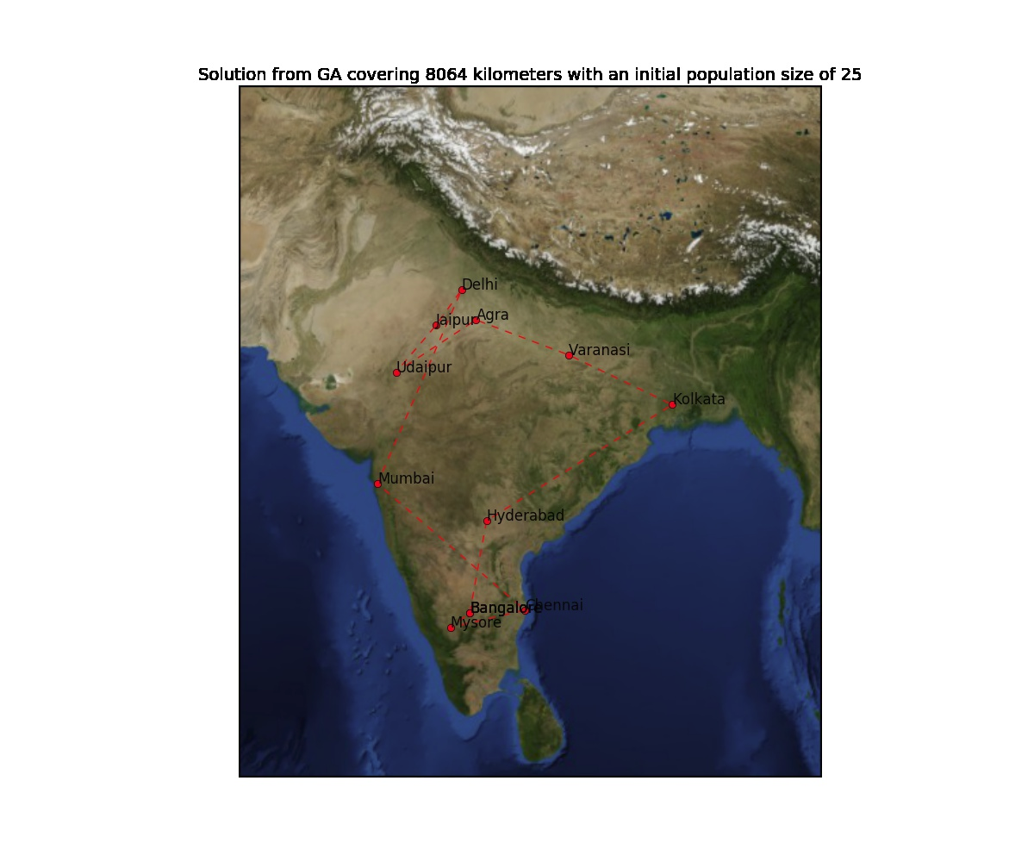

Slide 12
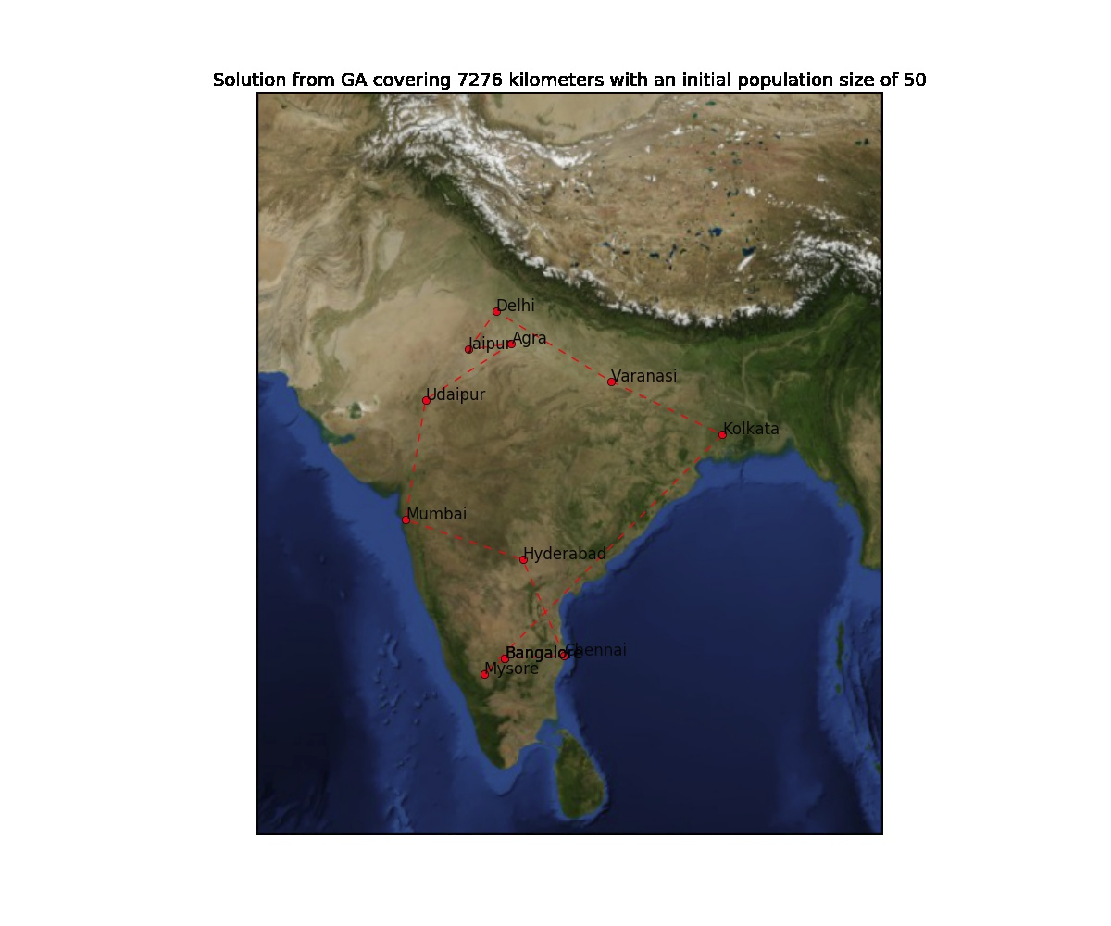

Slide 13


Slide 14


Slide 15
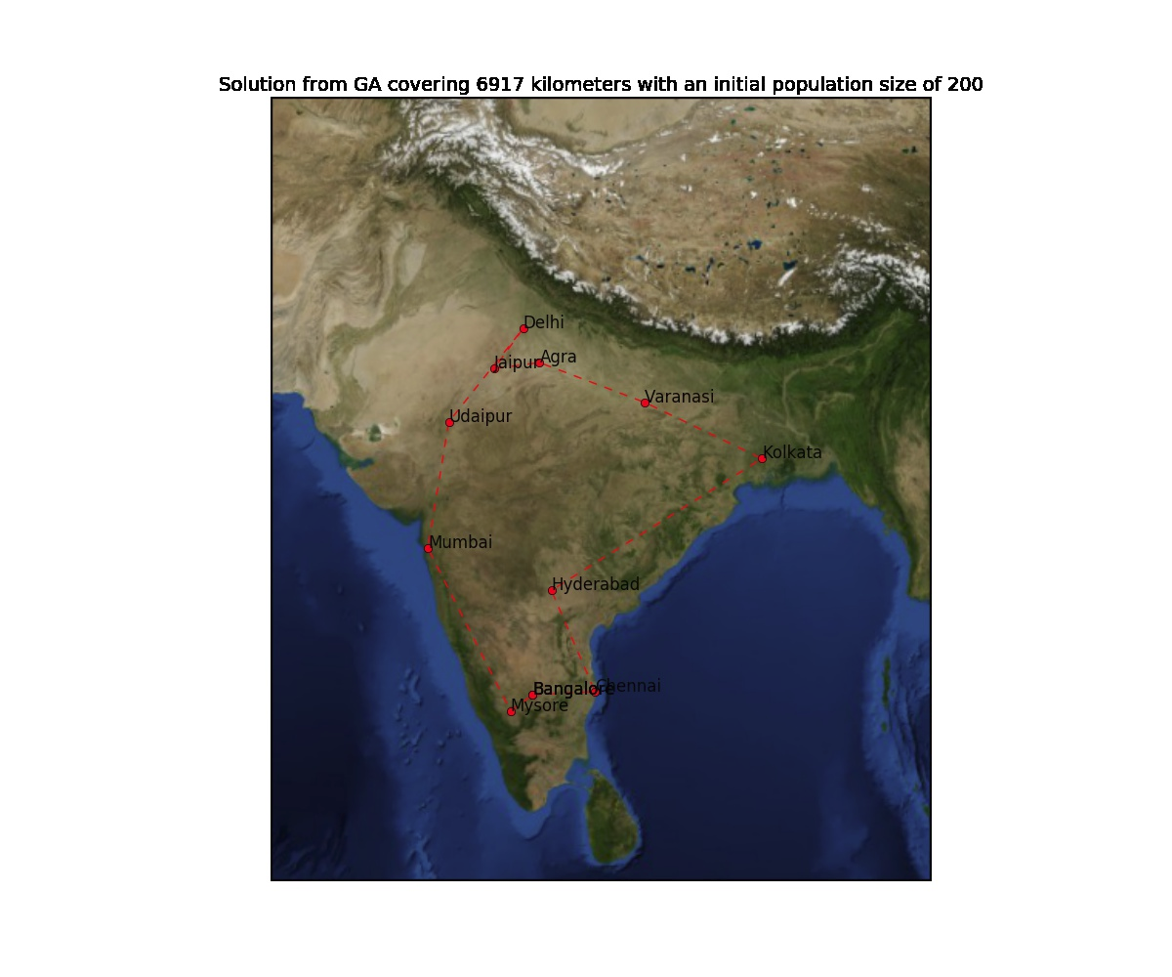

Slide 16


Slide 17


Slide 18
Final Solution
Total distance travelled to cover the final solution
Bangalore => Chennai => Hyderabad => Kolkata => Varanasi => Delhi => Agra => Jaipur => Udaipur => Mumbai => Mysore => Bangalore is 6815 Km.

Slide 19
Conclusion
We now have an overview of the working of genetic algorithms.
Understood how we can implement mutation and crossover.
We have seen how to code genetic algorithm in python from scratch.
Tried solving the travelling salesman problem using genetic algorithms.

